Slide 1
Clustering and Differential Expression
Introduction to Single Cell RNA-Seq (45)
Timothy Tickle
Brian Haas

Slide 2
Agenda (Clustering and Differential Expression)
Dimensionality Reduction
PCA
t-SNE
Differential Expression
SCDE
MAST

Slide 3
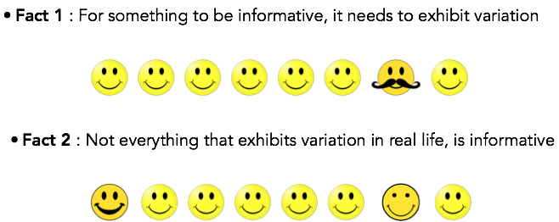
Making Sense of Variation

Slide 4
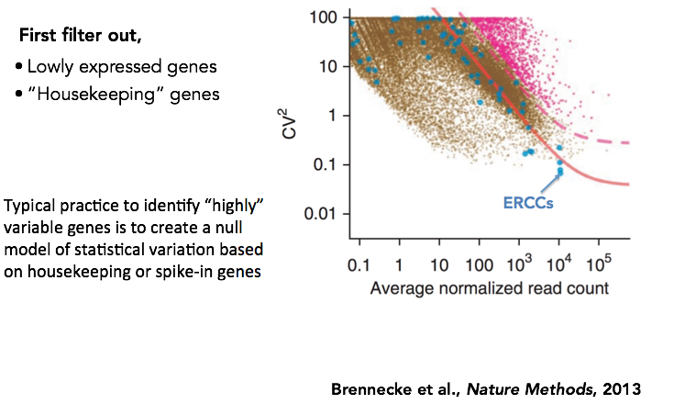
Identifying Relevant, “Highly Variable” Genes

Slide 5
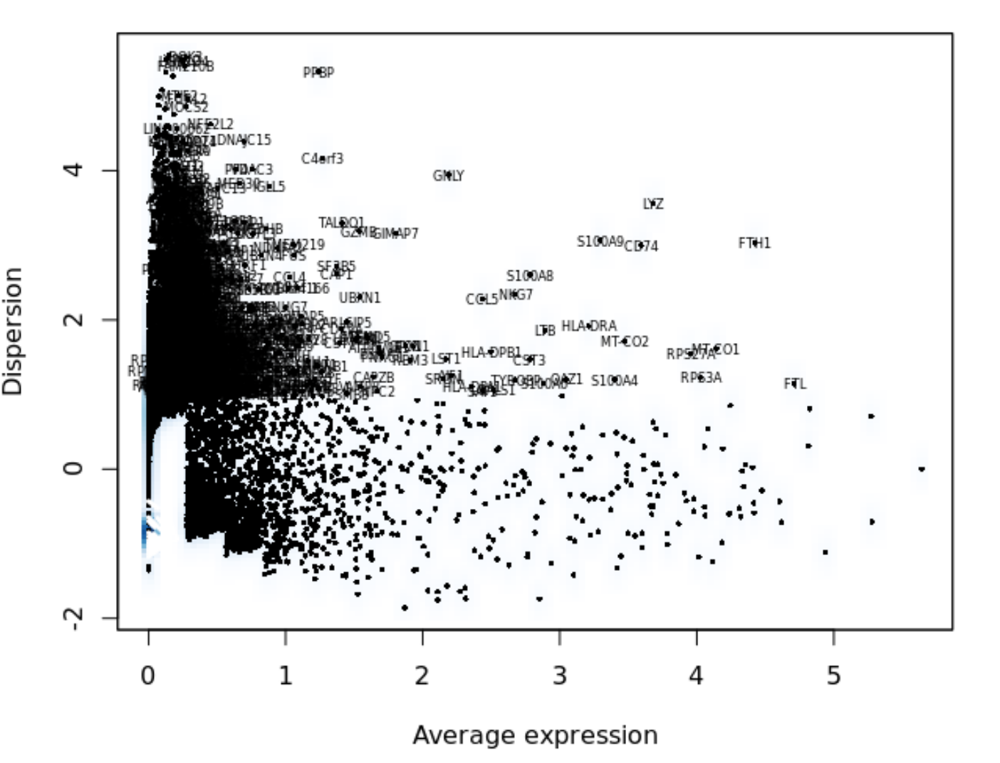
Variable Genes in Seurat
Calculate mean expression.
Calculate disperstion (standard deviation).
Calculate z-score for dispersions within each bin.
Stratifies and controls from the relationship between the variability and mean expression.
Default Standard Deviation

Slide 6
Dimensionality Reduction
•Start with many measurements (high dimensional).
Want to reduce to few features (lower-dimensional space).
•One way is to extract features based on capturing groups of variance.
•Another could be to preferentially select some of the current features.
We have already done this.
•We need this to plot the cells in 2D (or ordinate them)
•In scRNA-Seq PC1 may be complexity or technical.

Slide 7
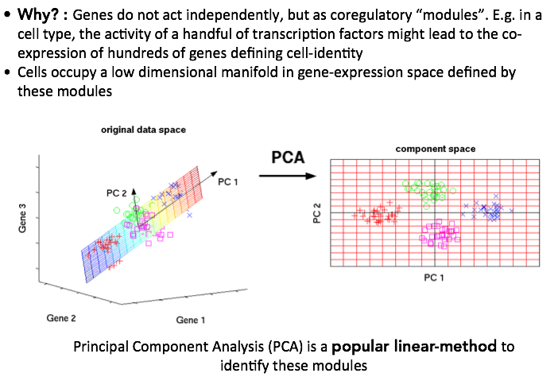
Dimensionality Reduction

Slide 8
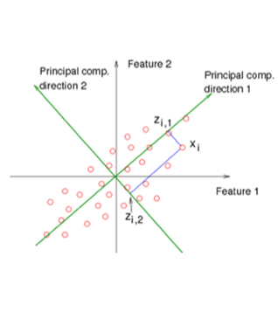
PCA: Overview
•Eigenvectors of covariance matrix.
•Find orthogonal groups of variance.
•Given from most to least variance.
Components of variation.
Linear combinations explaining the variance.

Slide 9
PCA: an Interactive Example
PCA Explained Visually

Slide 10
PCA: in Practice
Things to be aware of-
•Data with different magnitudes will dominate.
Zero center and divided by SD.
•(Standardized).
•Can be affected by outliers.
•Data is often first filtered to remove noise.

Slide 11
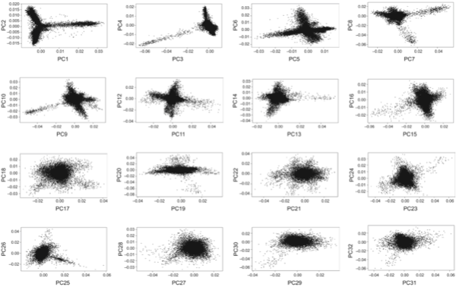
PCs
Notice how lower PCs look more and more “spherical” - this loss of structure indicates that the variation captured by these PCs mostly reflects noise.

Slide 12
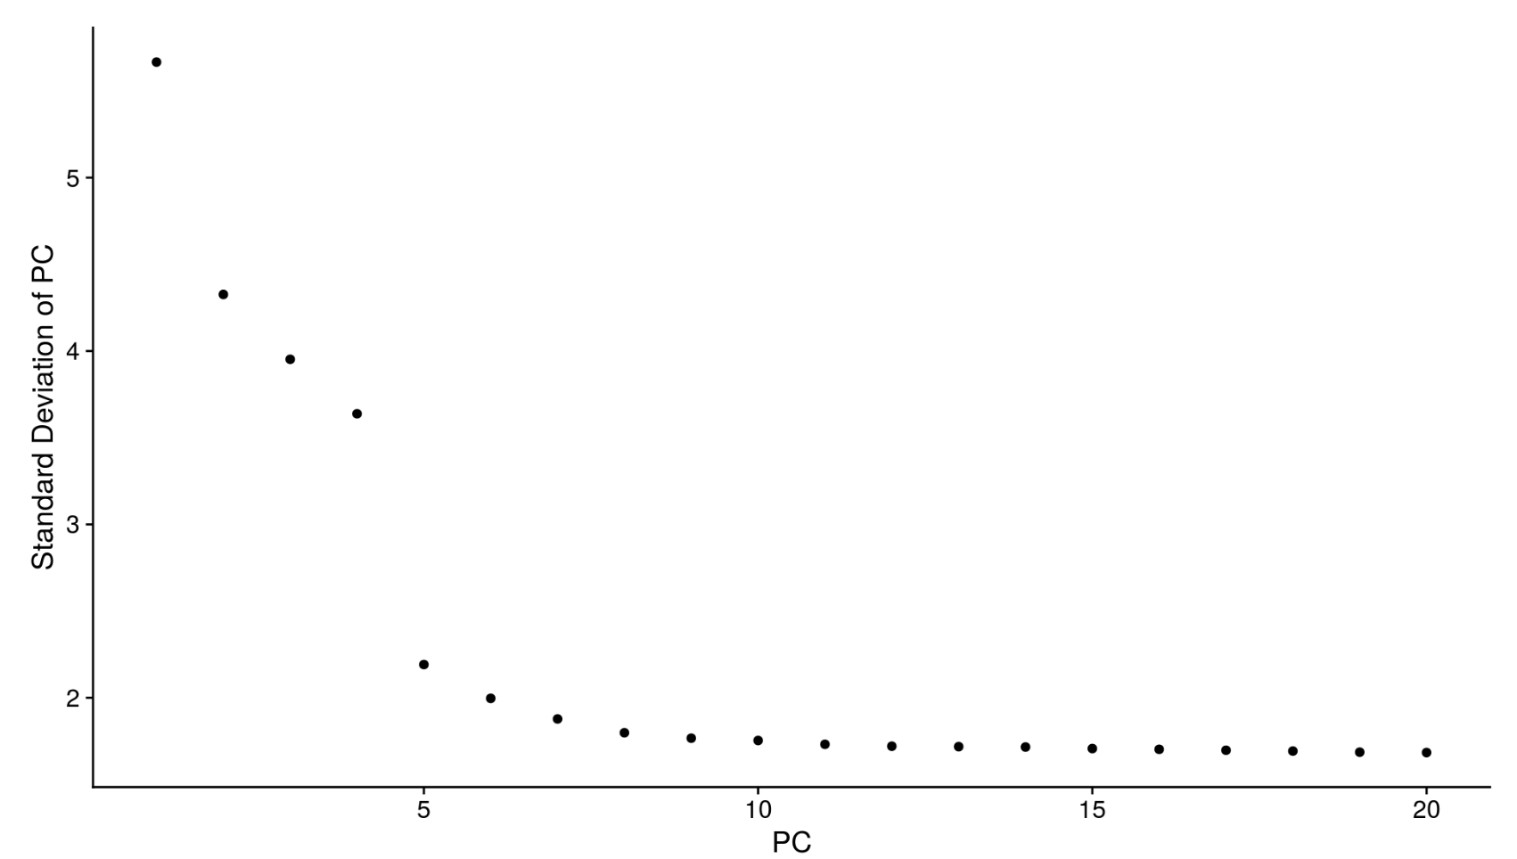
How Many Components Should We Use?
Elbow Plot (Scree Plot)

Slide 13
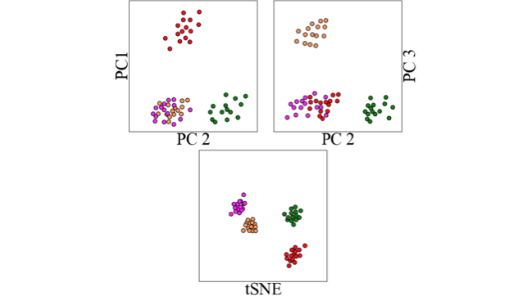
t-SNE: Collapsing the Visualization to 2D

Slide 14
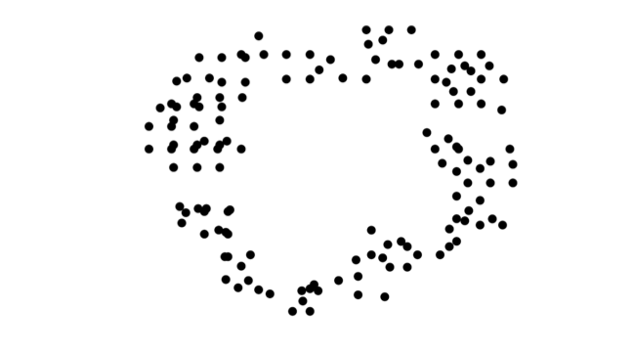
t-SNE: Nonlinear Dimensionality Reduction

Slide 15
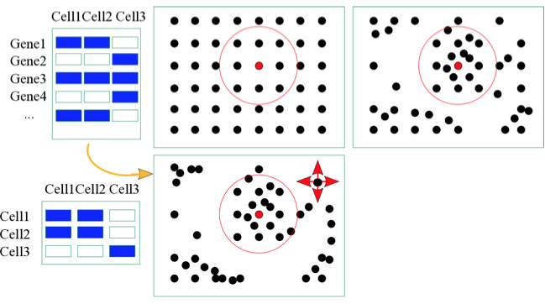
t-SNE: How it Works

Slide 16
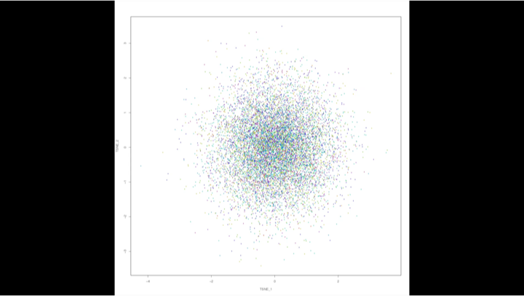
Visualizing t-SNE

Slide 17
PCA and t-SNE Together
•Often t-SNE is performed on PCA components
Liberal number of components.
Removes mild signal (assumption of noise).
Faster, on less data but, hopefully the same signal.

Slide 18
Plotting Metadata on Ordinations
X
✅
Metadata
Gene Expression
✅
X

Slide 19
Caution When Interpreting t-SNE
Nonlinear Optimized for local distanct
Big clusters can just mean more cells.

Slide 20
Learn More About t-SNE
•Awesome Blog on t-SNE parameterization
http://distill.pub/2016/misread-tsne
•Publication
https://lvdmaaten.github.io/publications/papers/JMLR_2008.pdf
•Nice YouTube Video
https://www.youtube.com/watch?v=RJVL80Gg3lA
•Code
https://lvdmaaten.github.io/tsne/
•Interactive Tensorflow
http://projector.tensorflow.org/

Slide 21
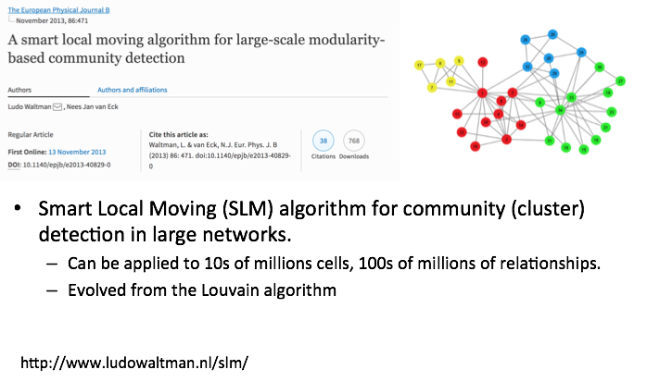
Defining Clusters Through Graphs
Notes:
The modularity of a network is a value
that is between -1 and 1. This value presents the density of
links inside communities over the density of links between
communities.

Slide 22
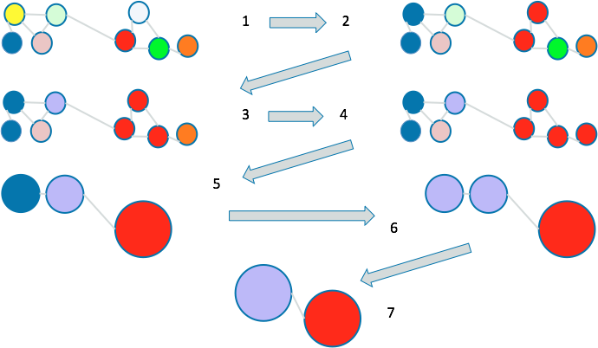
Local Moving Heuristic
Notes:
This is the louvain algorithm, the difference with this and the SLM is that when communities are made the community is broken down to nodes and then larger communities are recreated, incase one node would better live in another community.

Slide 23
Agenda (Clustering and Differential Expression)
Dimensionality Reduction
PCA
t-SNE
Differential Expression
SCDE
MAST

Slide 24
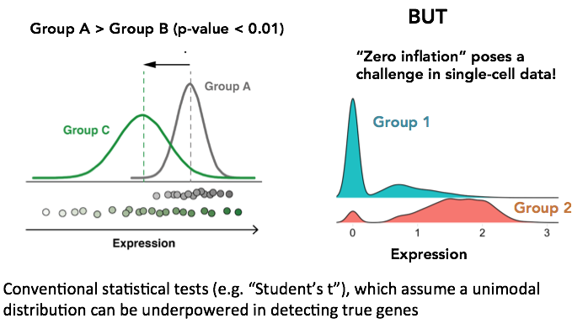
Differential Expression

Slide 25
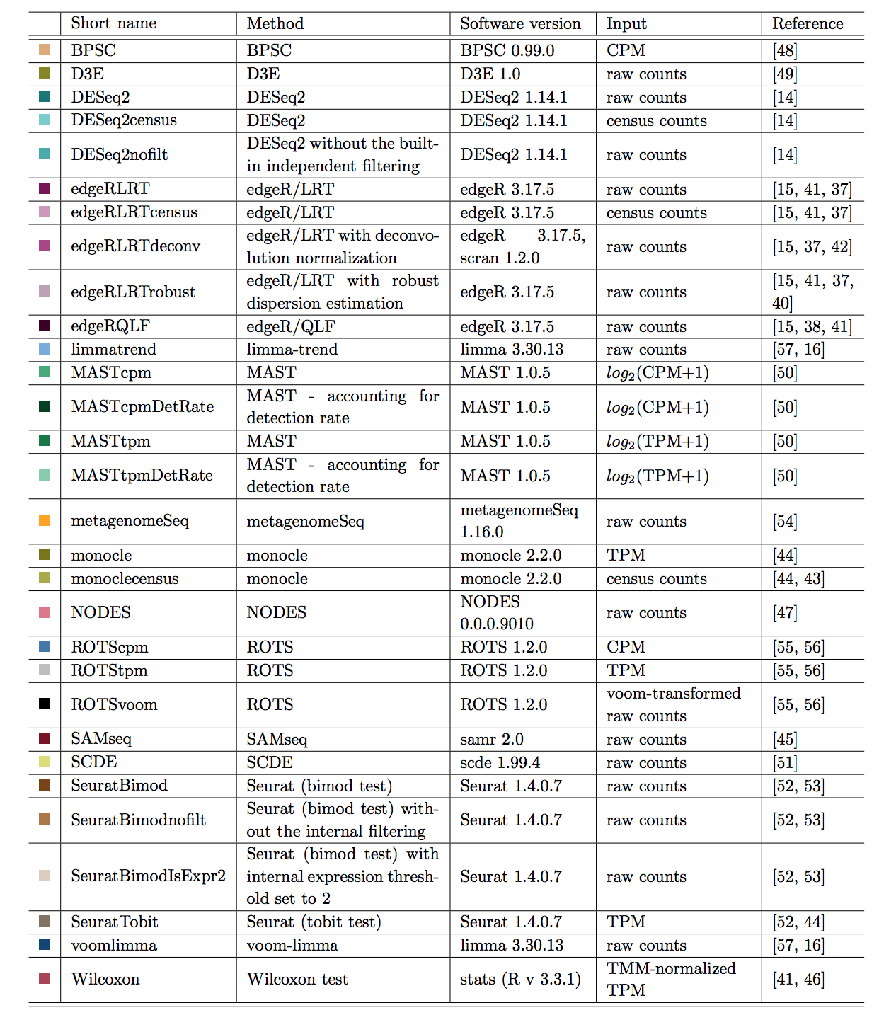
Differential Expression Analysis
Many of the DE methods developed for bulk RNA-seq (e.g. edgeR, DE-seq) have serious limitations when applied to scRNA-seq data because of dropouts, so apply with caution!
Soneson and Robinson, 2017

Slide 26
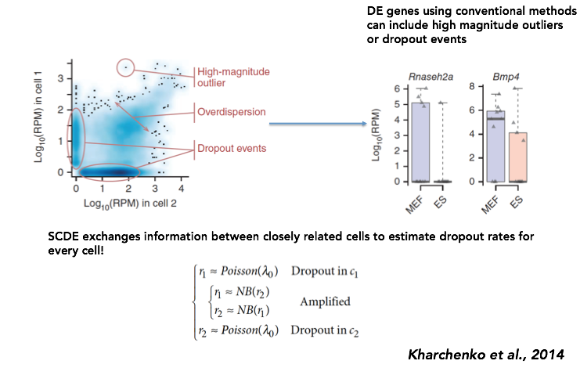
Single Cell Differential Expression (SCDE)

Slide 27
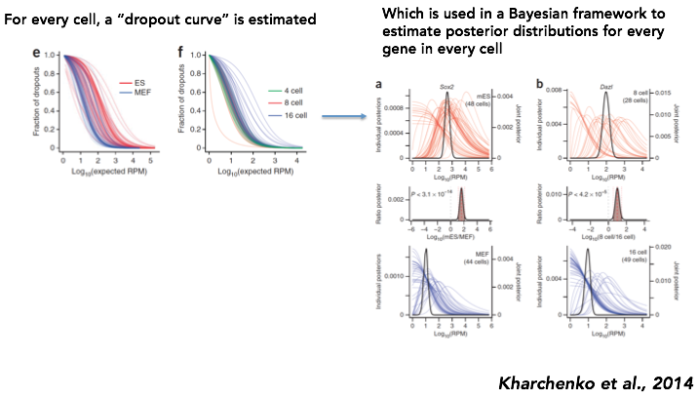
Singe Cell Differential Expression (SCDE)

Slide 28
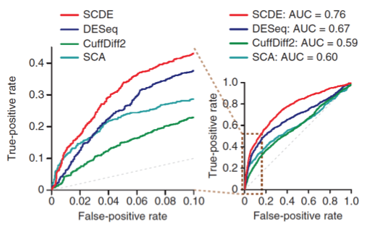
SCDE is Much More Sensitive and Specific
One of the disadvantages of SCDE is its run-time, which does not scale well for large datasets. Newer methods like MAST (Finak et al., 2016) overcome this!

Slide 29
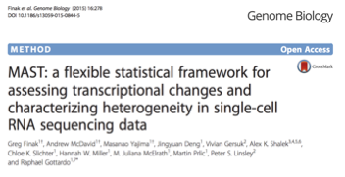
MAST
•Uses hurdle model
Two part generalized linear model to address both rate of expression (prevalence) and expression.
GLM means covariates can be used to control for unwanted signal.
•CDR: Cellular detection rate
Cellular complexity
Values below a threshold are 0
Additionally introduces a GSEA method
https://github.com/RGLab/MAST

Slide 30
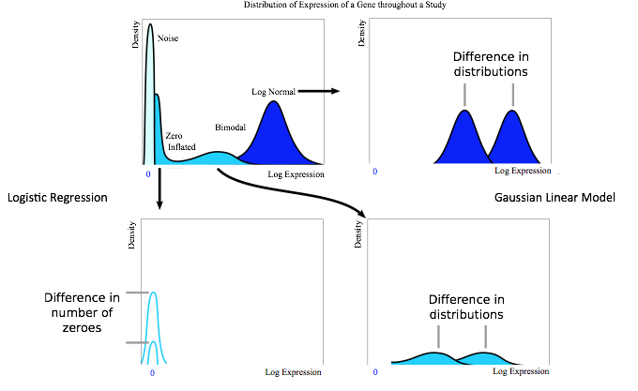
MAST: Hurdle Models

Slide 31
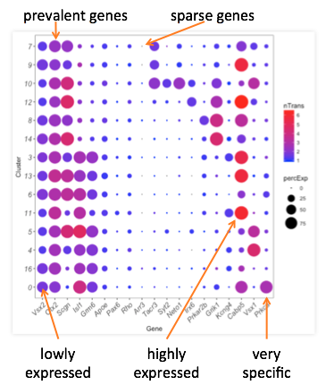
Dot Plots
Size of circle
•Gene prevalence in cluster.
Color of circle
•More red, more expressed in cluster.
Scales well with many cells.

Slide 32
Seurat: Differential Expression
•Default if one cluster again many tests.
Can specify an ident.2 test between clusters.
•Adding speed by excluding tests.
Min.pct - controls for sparsity
Min percentage in a group
Thresh.test - must have this difference in averages.

Slide 33
Seurat: Many Choices of DE
Bimod - Tests differences in mean and proportions.
Roc - Uses AUC like definition of separation.
T - Student's T-test.
Tobit - Tobit regression on a smoothed data.
MAST - Hurdle model for zero inflated data
….

Slide 34
Section Summary
We motivated dimensionality reduction with the helpfulness of focusing on higher variability.
We explored several methods for dimensionality reduction.
Contrasted and showed how to leverage together.
Explored differential expression.

